Slide 1
Statistical learning and prediction
Tree and ensemble methods
Get course files from https://github.com/marjoleinF/IOPS-SLP

Slide 2

Trees
Good: Easily interpretable and applicable
Bad: Not most accurate method
Ugly: Unstable

Slide 3

Example dataset

Slide 4
Example dataset
Aim: predict depression based on personality scales
Predictor variables:
- Neuroticism: n1 through n6, ntot
- Extraversion: e1 through e6, etot
- Openness to experience: open1 through open5, opentot
- Altruism: altot
- Conscientiousness: contot
- Covariates: sex (sexo) and age (edad)
Response variable:
- Beck Depression Inventory total score (bdi)
Sample size: N = 112

Slide 5

R code example

Slide 6
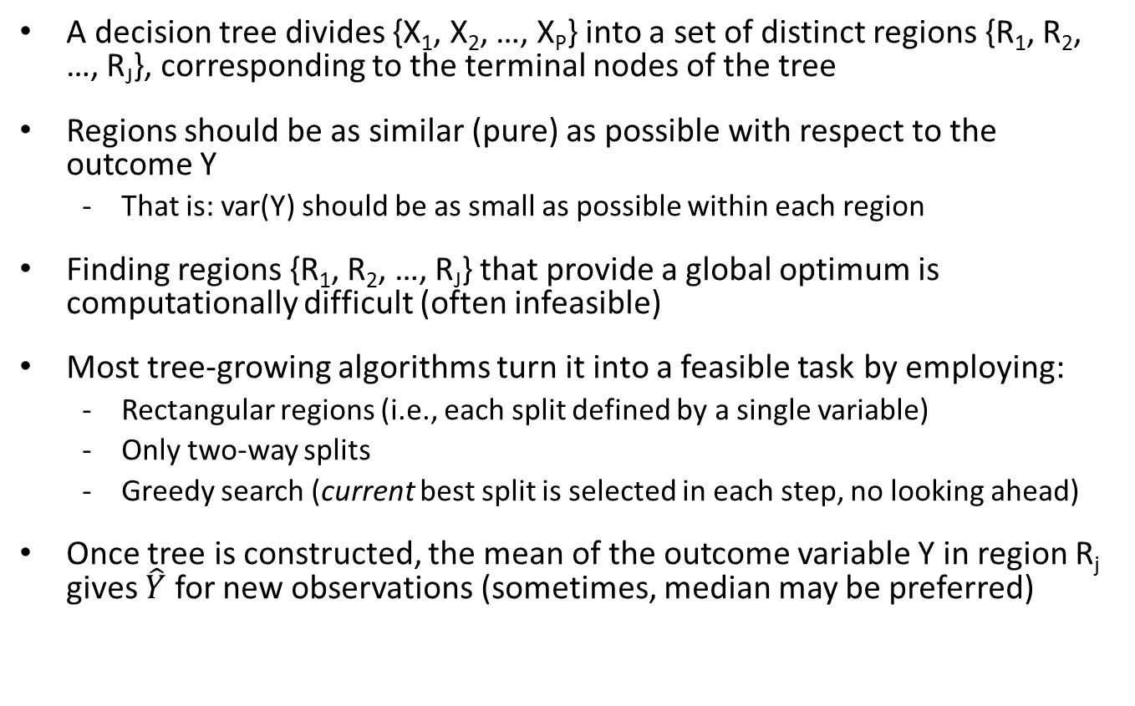
Tree-growing algorithms (e.g., CART)
A decision tree divides {X₁, X₂, …, X_{P}} into a set of distinct regions {R₁, R₂, …, R_{J}}, corresponding to the terminal nodes of the tree
Regions should be as similar (pure) as possible with respect to the outcome Y
That is: var(Y) should be as small as possible within each region
Finding regions {R₁, R₂, …, R_{J}} that provide a global optimum is computationally difficult (often infeasible)
Most tree-growing algorithms turn it into a feasible task by employing:
Rectangular regions (i.e., each split defined by a single variable)
Only two-way splits
Greedy search (current best split is selected in each step, no looking ahead)
Once tree is constructed, the mean of the outcome variable Y in region R_{j} gives $\hat{Y}$ for new observations (sometimes, median may be preferred)

Slide 7
Splitting criteria
At each step, we seek variable j and value s that define
R_{left}(j,s) = { X | X_{j} < s } and R_{right}(j,s) = { X | X_{j} ≥ s } ,
which minimize the sum of the loss function in both regions
Different loss functions can be used, e.g.,
Regression trees:
Absolute loss:
Squared error loss:
Classification trees:
Classification error:
Gini index:
Cross-entropy:
Squared error loss and Gini index are most often used
Both minimize the variance within every terminal node

Slide 8
Exercise 1
Comparing misclassification indices

Slide 9
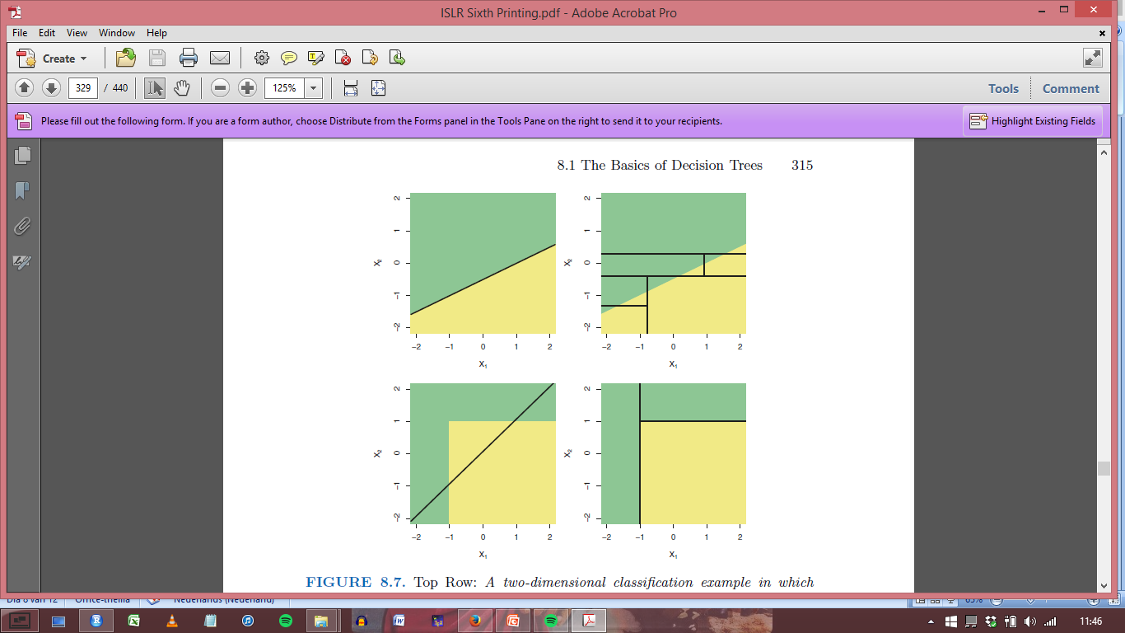
The bad
Trees do not provide optimal predictive accuracy, because:
Small trees have low variance, but (likely) high bias
Large trees have low bias, but high variance

Slide 10

The ugly - I: Instability
Trees have high variance / instability:
Each split is conditional on earlier splits
A split may come out different due to minor sampling variations. All further splits are conditional on that split. -> Minor sampling variations may greatly affect the tree structure.
Looks very ugly if you look at the tree structure (e.g., add or remove only a few observations to the data and the whole tree may be different).
However, very different tree structure may provide very similar predictions, due to correlated covariates. Instability may look worse than it is.

Slide 11
R code example

Slide 12
Balancing bias and variance
Solution 1: Pruning
tree should not be too small, nor too large
How?
grow full tree untill impurity cannot be further reduced
cut of branches by selecting the tree that minimizes the penalized loss function:
where T equals the # of terminal nodes; α should be determined by k-fold CV

Slide 13
The ugly – II: Biased variable selection
CART performs exhaustive search: for every split, all possible splitting values are considered
-> biased variable selection: given two (or more) variables who are equally predictive of the outcome, variable with largest number of possible splitting values has higher probability of being selected for splitting
Solution: First select splitting variable, then select splitting value
-> unbiased variable selection: variables with equal predictive power have equal probability of being selected

Slide 14
Unbiased recursive partitioning
Conditional inference trees: Select splitting variable based on statistical tests
Separates variable and cutpoint selection
-> no selection bias towards variables with larger number of values
Provides Solution 2 for balancing bias and variance: Yields natural stopping criterion: Significance level

Slide 15
Conditional inference trees
Statistical testing to select splitting variable:
H0_{j}: variable X_{j} and response Y are independent in the population
HA_{j}: variable X_{j} and response Y are dependent in the population
Thus, for each variable X_{j} a p value under H0 can be calculated, based on the observations in the current node
Variable X_{j} with lowest p value is selected for splitting the observations into two daughter nodes
If all p values in current node > pre-specified value α, no further splitting is performed
After selecting splitting variable, select cutpoint as with CART (i.e., optimize loss function in daugthernodes)
Implemented in R in ctree() function of package ‘partykit’

Slide 16
Exercise 2
Variable selection bias

Slide 17
Trees
Good: Easily interpretable and applicable
Bad: Not most accurate method
Ugly: Unstable

Slide 18
Tree ensembles
Single trees
Small trees have low variance, but high bias
Large trees have low bias, but high variance
Tree ensembles
By combining the fitted (predicted) values from a large number of single trees, variance is reduced
A price is paid in interpretability: instead of a single tree, we get a large number of trees

Slide 19
Ensemble learning
Predictions of a large number of weak learners (e.g., single trees) are combined to create a strong learner (e.g., ensemble of trees)
Other learners than trees may be ensembled, too
A weak learner is a method that has at least some predictive ability, that is at least better than random guessing
Predictive accuracy of the full ensemble is always equal or better than that of any of its constituent members

Slide 20
Ensemble learning
Ensembling works well for unstable learning algorithms
(algorithms whose output undergoes major changes in response to small changes in the training data)
Unstable learning algorithms (generally, relatively): e.g., decision trees, neural networks, rule learning algorithms, OLS regression
Stable learning algorithms (generally, relatively): e.g., penalized linear regression, nearest neighbour, linear threshold algorithms
Popular tree ensemble methods :
Bootstrap aggregation (bagging)
Random forests
Boosting

Slide 21
Bagging
Sampling rows of X decorrelates trees
A bagged tree ensemble is constructed by
Taking bootstrap samples from the training data
Fitting a tree on each of the bootstrap samples
Combining the trees into an ensemble

Slide 22
Random forests
Sampling rows of X
A random forest is constructed by
Taking bootstrap samples from the training dataset
Fitting a tree on each of the bootstrap samples, using a random subset of predictor variables for each split
Combining the trees into an ensemble
Sampling columns of X
Double decorrelation of trees and reduction of variance

Slide 23
Tuning parameters (bagging and random forests)
ntrees (# of trees / samples)
Sensible default: 500 (bagged and RF ensembles hardly overfit)
nodesize & maxnodes (treesize)
Sensible defaults:
nodesize: 1 for classification, 5 for regression
maxnodes: no limit (ensembling trees reduces variance, so trees may as well be large, with low bias)
mtry (# of predictor vars used for split selection)
Sensible default: mtry = p for bagging, mtry = srtq(p) for RF
replace (sampling with or without replacement)
Sensible default: Bootstrap sampling (replace = TRUE)
Bootrapping increases likelihood of noise variables being selected. Subsampling (replace = FALSE) may perform better in terms of variable inclusion frequencies (De Bin et al., 2014).

Slide 24
R code example

Slide 25
Out-of-bag error estimation
When trees are grown on bootstrap or sub samples of the data, we do not need separate test data for error estimation:
For each training observation i, predict Y using trees that were grown on samples not including observation i (out-of-bag)
Then calculate as usual:

Slide 26
Interpretation
The price for the better predictive accuracy of ensembles, compared to single trees, is interpretability
Variable importances aid in interpretation of the model
For bagging and random forests, relative importance of variable X_{j} is assessed as follows:
For every tree in the ensemble:
1) Predictive accuracy for OOB observations is computed
2) Predictive accuracy for OOB observations, with values of Xj randomly permuted are computed
Difference between accuracies under 1) and 2), averaged over all trees in the ensemble, is used to calculate importance of X_{j}

Slide 27
Boosting
The variance of the ensemble is reduced more when trees (and predictions) are less correlated
Bagged ensembles decorrelate through sampling of observations
Random forests doubly decorrelate through sampling observations as well as variables
Boosting decorrelates trees through growing them sequentially: each tree is grown on the residuals of earlier trees

Slide 28
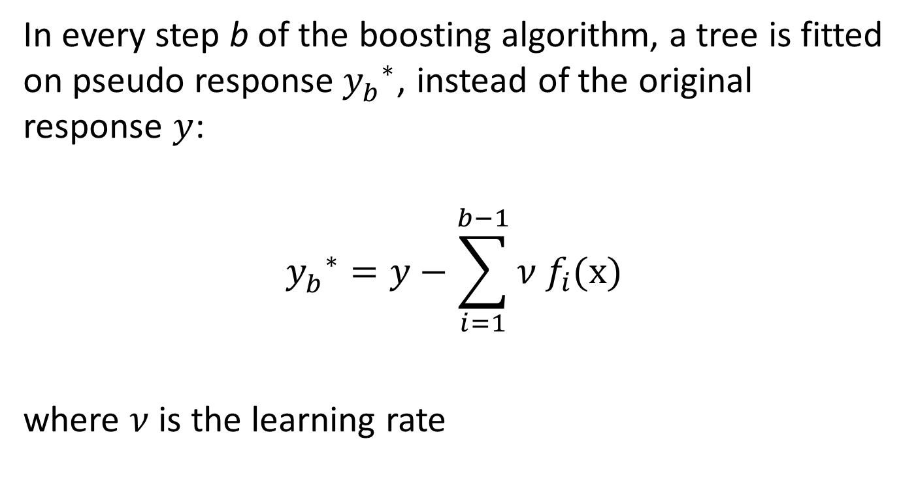
Pseudo response variable in boosting
In every step b of the boosting algorithm, a tree is fitted on pseudo response${y_{b}^{}}^{∗}$, instead of the original response $y$:
$${y_{b}^{}}^{∗}=y−\sum_{i=1}^{b−1}{ν f_{i}(\text{x})}$$
where $ν$ is the learning rate

Slide 29
Tuning parameters (boosting)
Boosting does overfit, have to determine optimal parameter values by CV!
interaction.depth (tree depth):
Should be relatively low (boosting works best with weak learners)
Rule of thumb: interaction.depth = 4
n.trees (# of trees):
Rule of thumb: at least 1 / shrinkage
shrinkage (learning rate):
At least 1 / n.trees
bag.fraction (fraction of training observations randomly selected for each sample)
Bootstrap sampling (bag.fraction < 1) or no sampling (bag.fraction = 1)

Slide 30
Question
How can bagging and boosting be used for other methods than tree-based methods?
For instance, how can these be applied for linear regression and logistic regression and when is it especially beneficial to use bagging and boosting for these type of analyses?

Slide 31
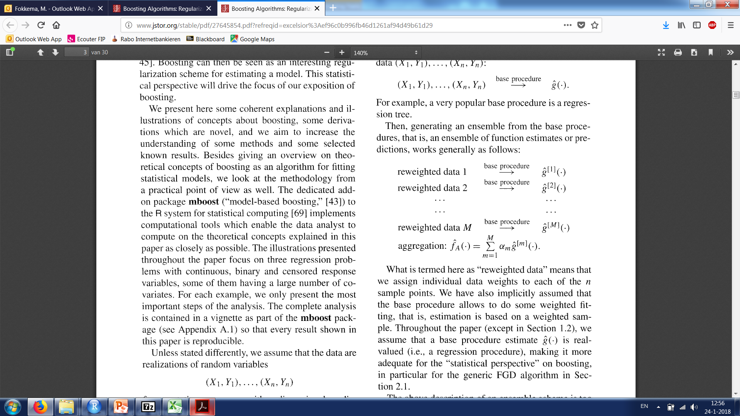
Ensemble methods: general view
Assume that the data are realizations of random variables:
with p-dimensional predictor variables X and one-dimensional response variable Y
We specify one (or more) base procedures, which produce a function estimate (that is, it maps input variables X to an output variable Y):
this base procedure can be any type of learner: tree, linear (identity) function, non-linear function, …

Slide 32
Ensemble methods: general view
Ensemble methods construct multiple function estimates or predictions from reweighted data:
… and use a linear combination thereof for producing the final, aggregated estimator or prediction:

Slide 33
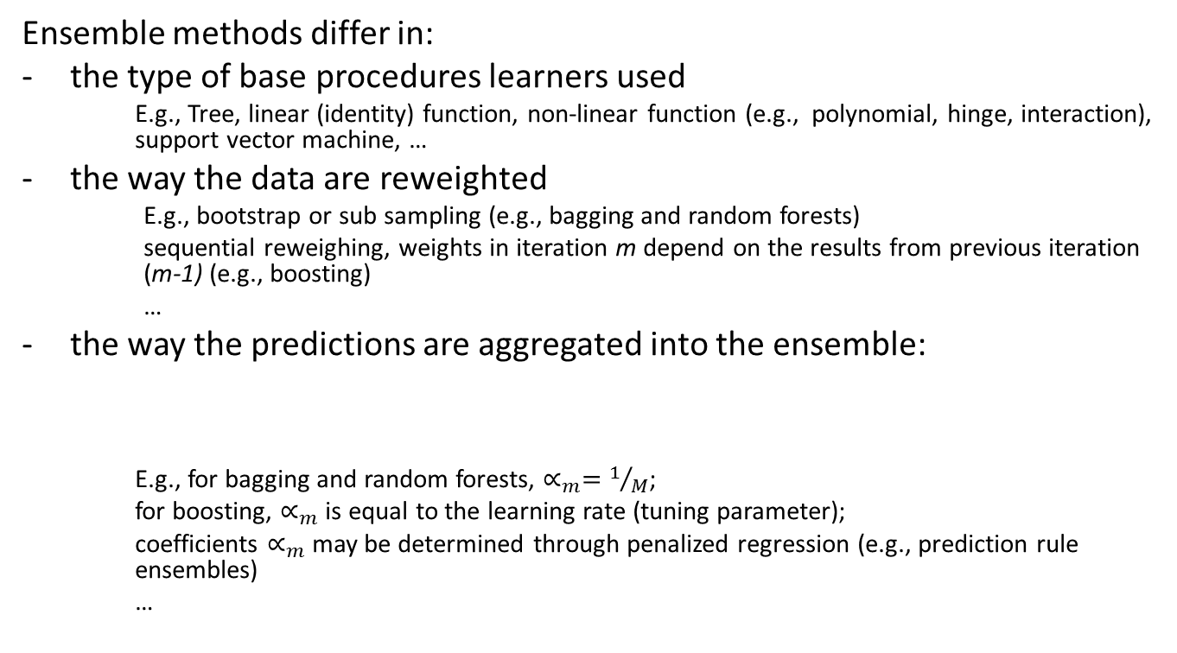
Ensemble methods: general view
Ensemble methods differ in:
the type of base procedures learners used
E.g., Tree, linear (identity) function, non-linear function (e.g., polynomial, hinge, interaction), support vector machine, …
the way the data are reweighted
E.g., bootstrap or sub sampling (e.g., bagging and random forests)
sequential reweighing, weights in iteration m depend on the results from previous iteration (m-1) (e.g., boosting)
…
the way the predictions are aggregated into the ensemble:
E.g., for bagging and random forests, $∝_{m}=1/M$;
for boosting, $∝_{m}$ is equal to the learning rate (tuning parameter);
coefficients $∝_{m}$ may be determined through penalized regression (e.g., prediction rule ensembles)
…

Slide 34
R code example

Slide 35
Trees and ensembles: Concluding remarks
With a single tree, we trade in some predictive accuracy for interpretability
Depends on the context of the application if this is worth it, e.g.
Simple decision trees are pre-eminently suited as tools for human decision making (i.e., limited time and computational power)
Tree ensembles generally use all of the predictor variables: evaluation of all variables for new cases may be expensive / infeasible
If we have lots of data and computation power available, tree ensembles provide very good predictive accuracy
In data with little or no noise, boosting often outperforms random forests
In noisy data, random forests often outperform boosting
Boosting requires careful parameter tuning to perform well, random forest works well out-of-the-box
Boosting, bagging and random forest approaches can be combined
e.g., gbm() function uses bootstrap sampling by default

Slide 36
Exercises: 3 & 4 (and 5 if time permits)
References
De Bin, R., Janitza, S., Sauerbrei, W., & Boulesteix, A. L. (2015). Subsampling versus bootstrapping in resampling‐based model selection for multivariable regression. Biometrics, 72, 272-280.
Suggested further reading:
Introduction to trees and ensembles:
Strobl, C., Malley, J., & Tutz, G. (2009). An introduction to recursive partitioning: rationale, application, and characteristics of classification and regression trees, bagging, and random forests. Psychological Methods, 14(4), 323.
Unbiased recursive partitioning:
Hothorn, T., Hornik, K., & Zeileis, A. (2006). Unbiased recursive partitioning: A conditional inference framework. Journal of Computational and Graphical statistics, 15(3), 651-674.
Boosting and ensemble learning:
Bühlmann, P., & Hothorn, T. (2007). Boosting algorithms: Regularization, prediction and model fitting. Statistical Science 22(4), 477-505.
Trees for multilevel data:
Fokkema, M., Smits, N., Zeileis, A. , Hothorn, T. & Kelderman, H. (in press). Detecting treatment-subgroup interactions in clustered data with generalized linear mixed-effects model trees. Behavior Research Methods, https://doi.org/10.3758/s13428-017-0971-x .

